Slide 1


Extended preoperative chemotherapy
And preoperative radiotherapy
In pancreas cancer
Predictors of tumor response to neoadjuvant therapy in pancreatic cancer
“Nothing To Disclose”
Basem Azab, MD, Ms, FACP, FCAS

Slide 2


Slide 3


Slide 4
Background
Background
Pancreas cancer:
  3rd leading cause of cancer-related death in USA
  5-year OS for all comers is < 9%
  15%-20% have resectable disease-> 5-year OS ≈ 20%
Neoadjuvant chemotherapy (NCT):
  increased rate of R0
  Pathological complete response (pCR) has been a surrogate marker for improved survival

Slide 5
Perioperative Chemotherapy:
Perioperative Chemotherapy:
  Which chemo
  Neo- vs. adjuvant chemotherapy
  If NCT-> how long and +-NRT
  If NCT->metrics for response (not losing Rx window opportunity)

Slide 6

Which chemotherapy?

Slide 7
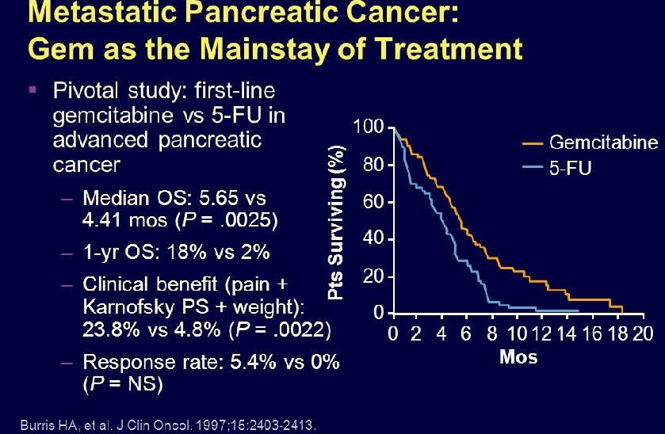

OS at 1year: Gem vs. 5-FU 18% vs. 2%.
“no one lived to tell the real story”

Slide 8
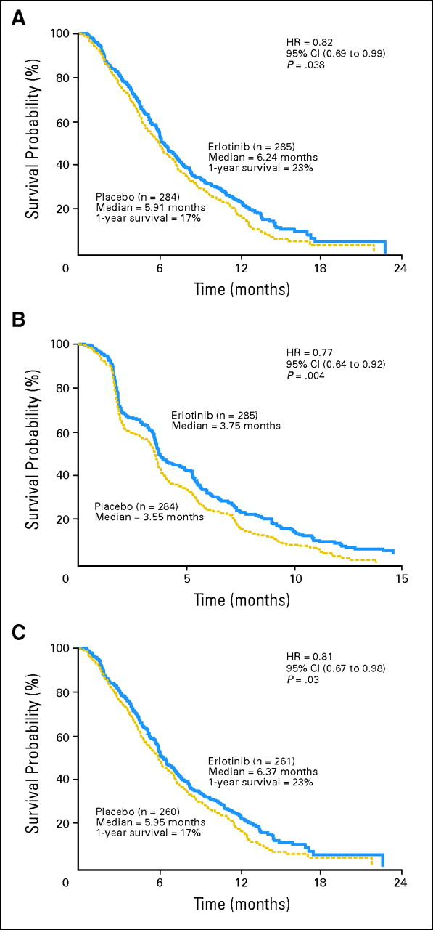
Moore et al. Erlotinib plus gemcitabine vs gem alone LA PDAC. phase III trial JCO. 2007. (>500 patients)
OS
Progression free survival
OS in 100mg
group

Slide 9
Moore et al. Erlotinib plus gemcitabine vs gem alone LA PDAC. phase III trial JCO. 2007. (>500 patients)
OS
Progression free survival
statistically significant
but not clinically.
OS in 100mg
group

Slide 10

FOLFIRINOX and Gem-abraxane era.

Slide 11
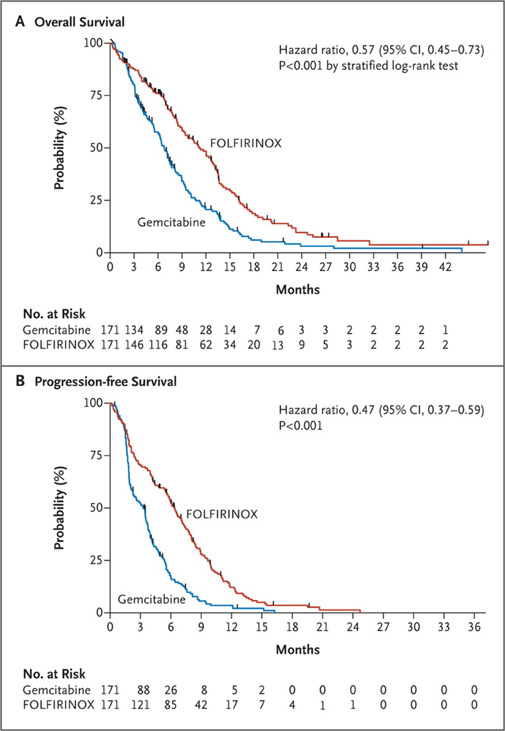


Conroy et al. FOLFIRINOX vs. gemcitabine for metastatic PC. NEJM 2011.
15 -> 48 centers. phase 3.
342 patients .
ACCORD trial

Slide 12
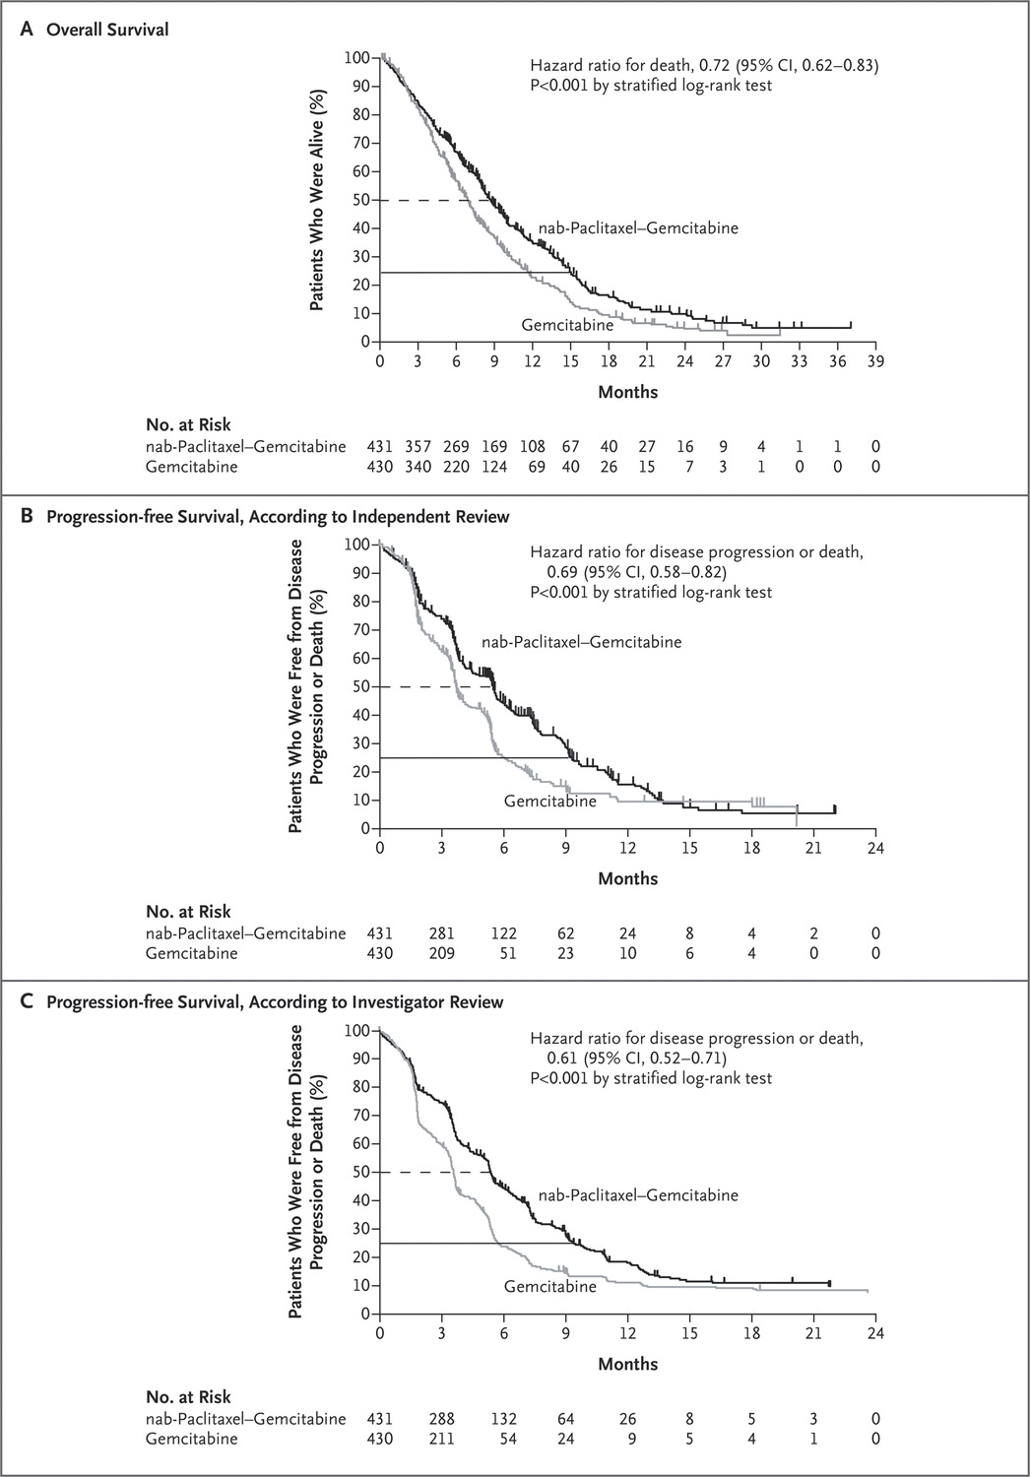
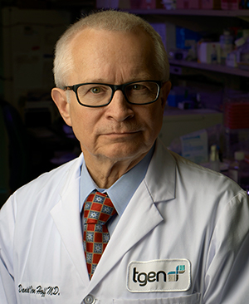

Von Hoff et al.
NEJM. 2013.
Met PC
>800patients.
Multicenters.
Phase 3.

Slide 13
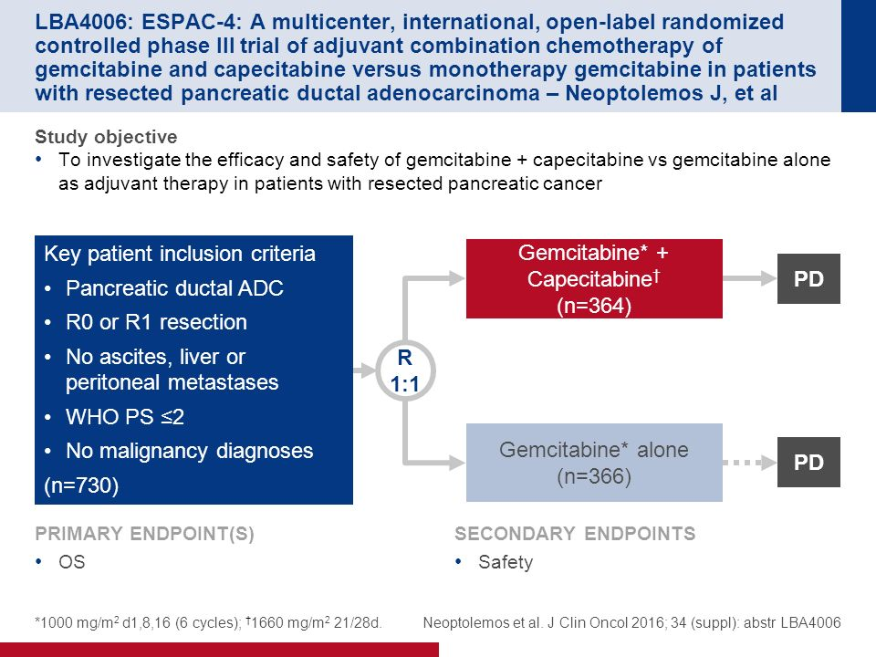

Slide 14
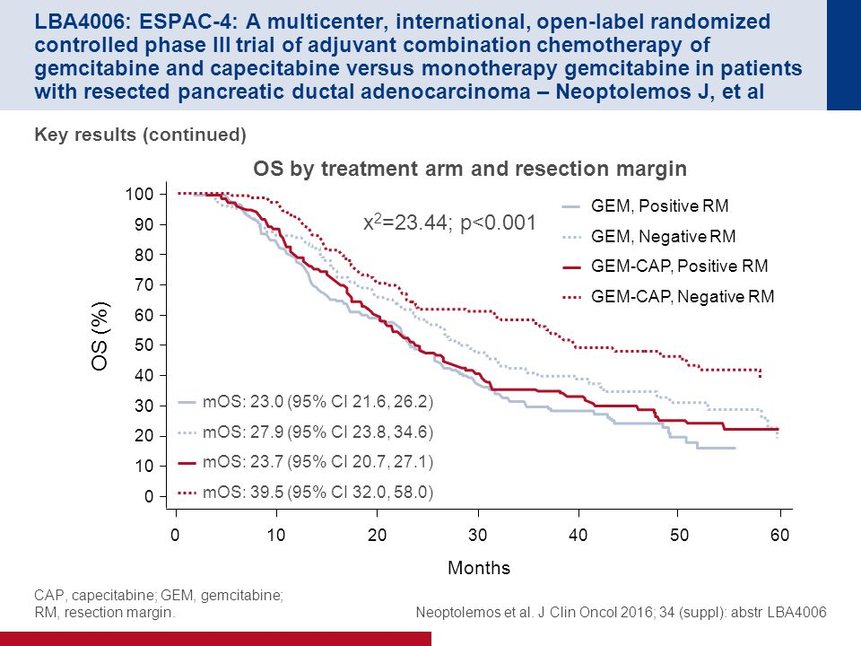

Slide 15
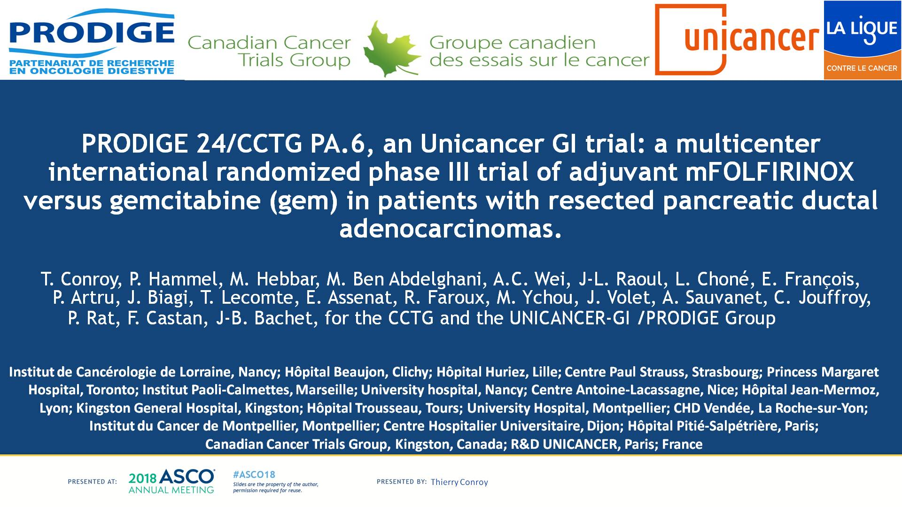

Slide 16
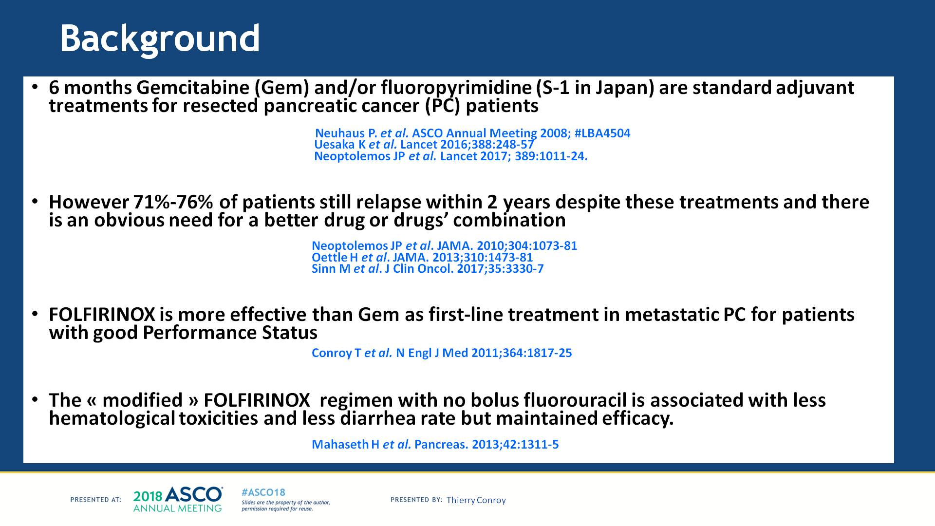

Slide 17
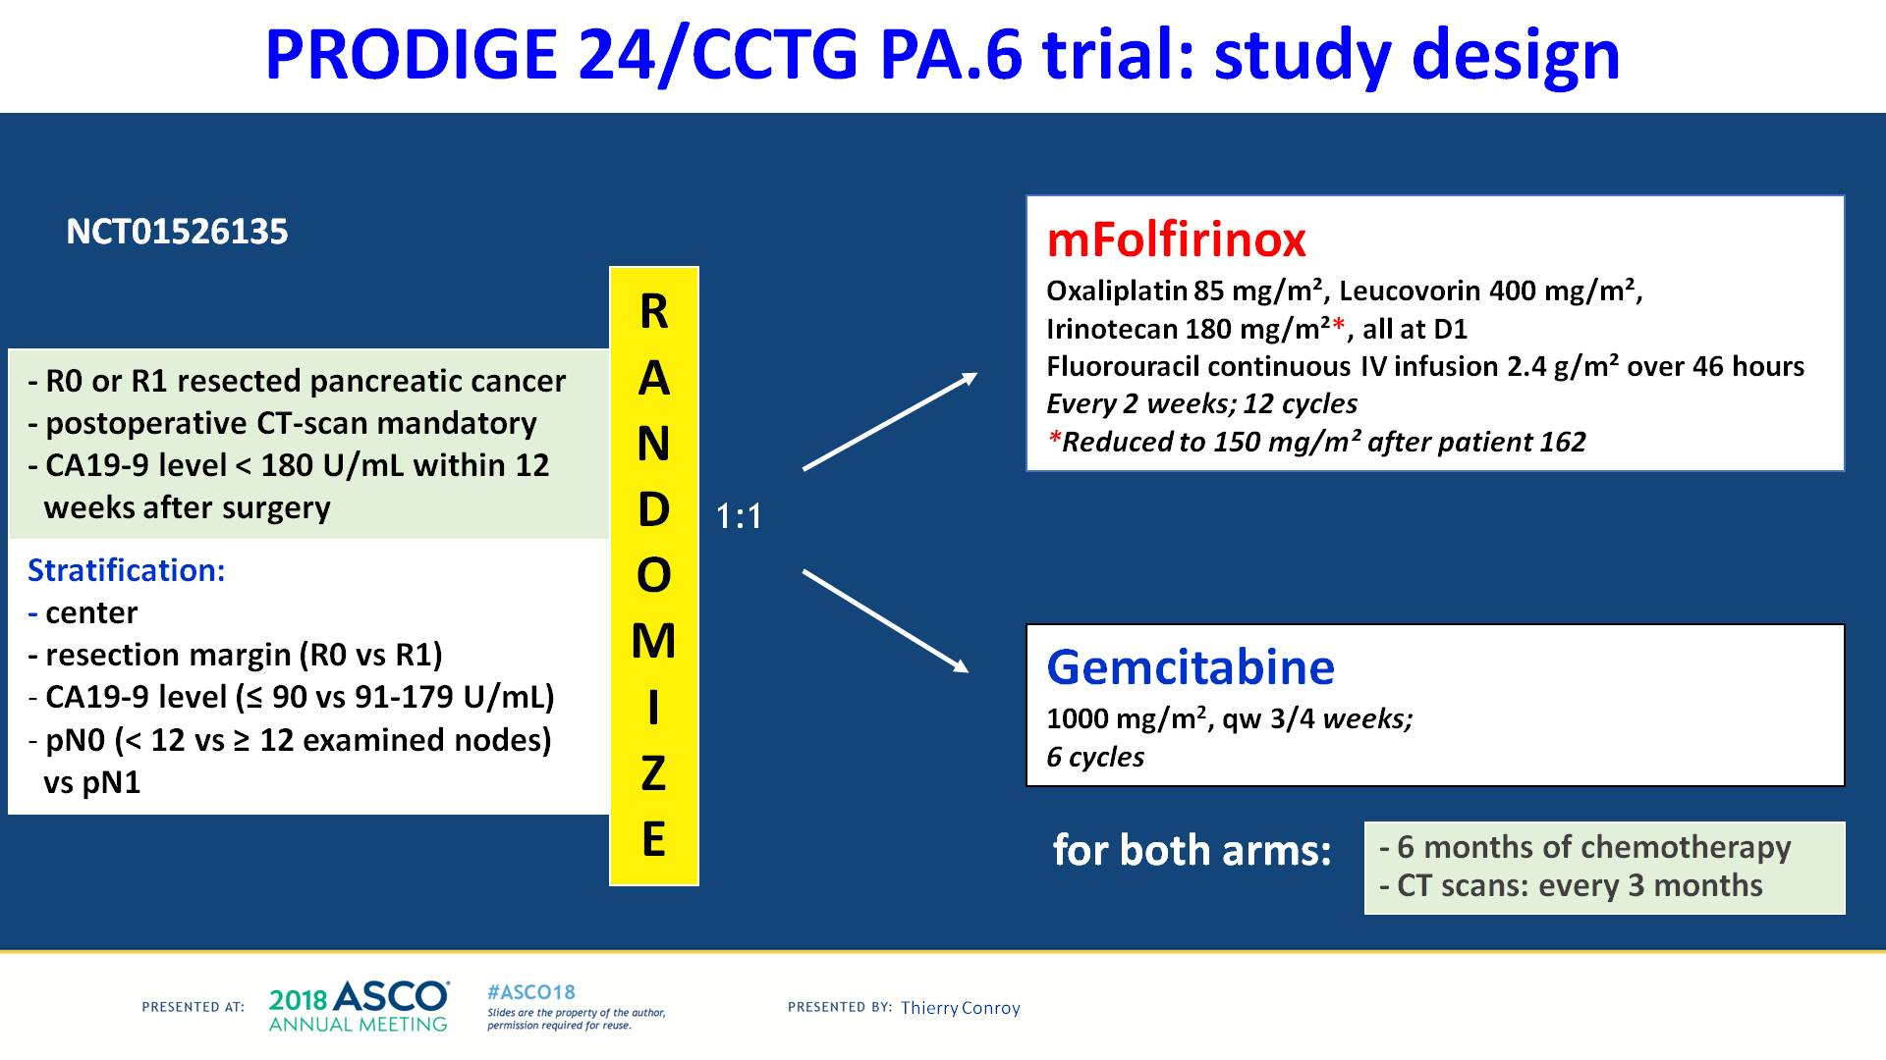

Slide 18
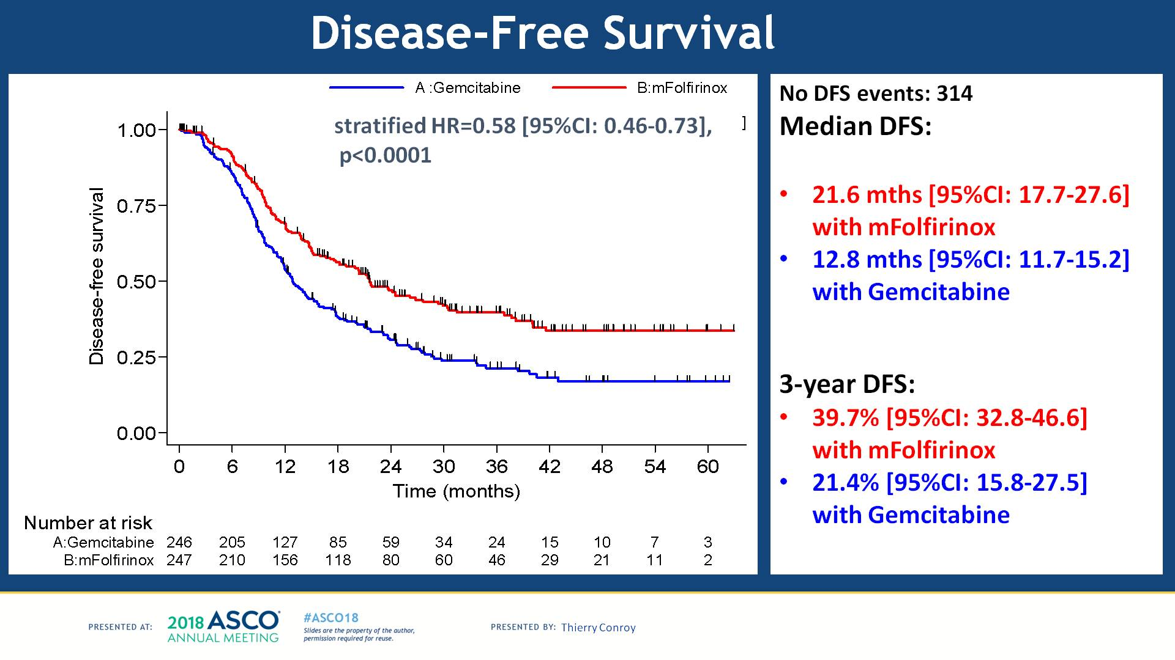

Slide 19
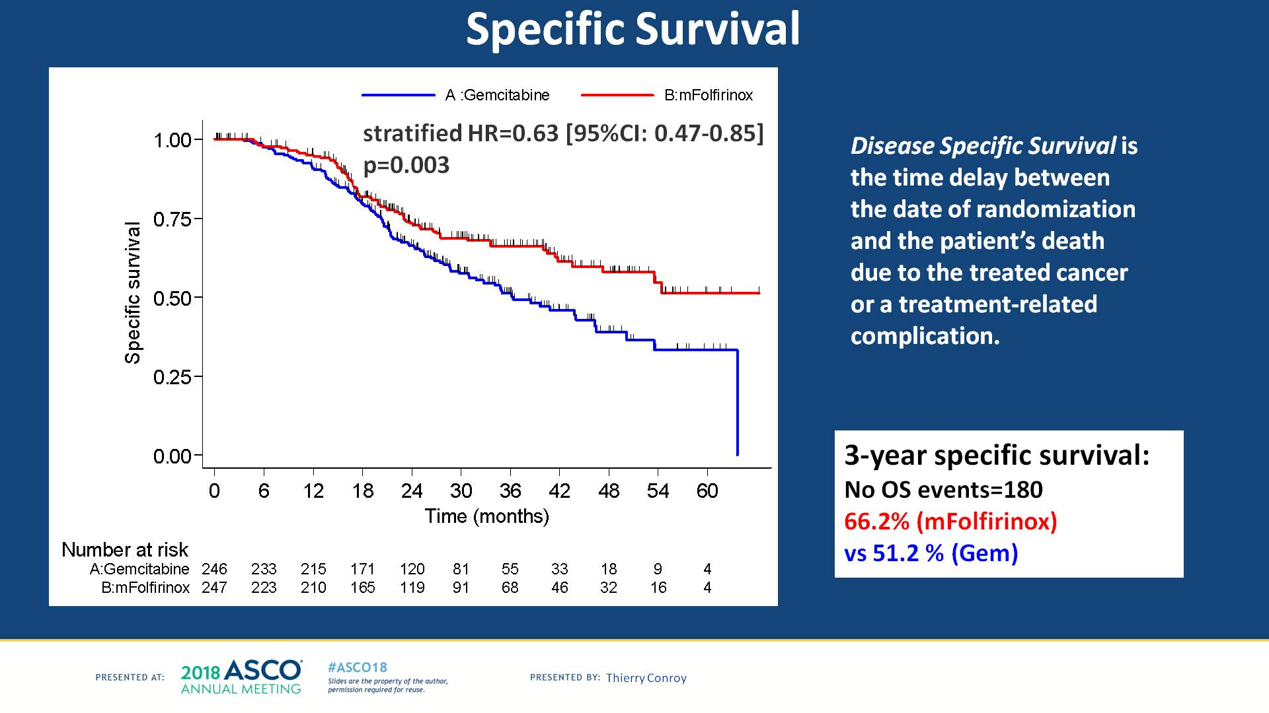
Slide 22
Presented By Thierry Conroy at 2018 ASCO Annual Meeting

Slide 20
Which chemo ?
FOLFIRINOX / Gem-Abraxane
√

Slide 21
Neo vs adjuvant?
“Neoadjuvant vs upfront surgery ?”

Slide 22
Background
NCT vs upfront surgery
Pros of NCT+-RT:
  Higher rate of R0
  Higher rate of pN0 stage
  Higher rate of treatment completion
  Proper time to evaluate both cancer biology & host response
  Better OS*
Cons of NC+-RT:
  Losing resection window opportunity for NCT non-responders
  Unnecessary NCT side effects among non-responders

Slide 23

NCT vs upfront surgery
In resected patients
Intention to treat
Artinyan et al-Retrospective Cancer May 2011 ↑Overall survival
Other small retrospectives
Versteijne et al metanalysis BJS July 2018
Jang et al RCT 2/3 Ann Surg Aug 2018
↑ R0 rate
↑ pN0 stage
↓Resection rate
↑ Overall survival

Slide 24
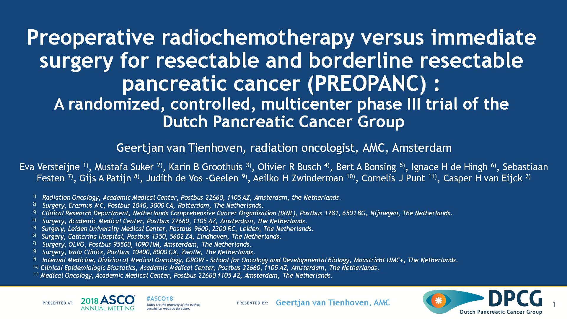

Slide 25
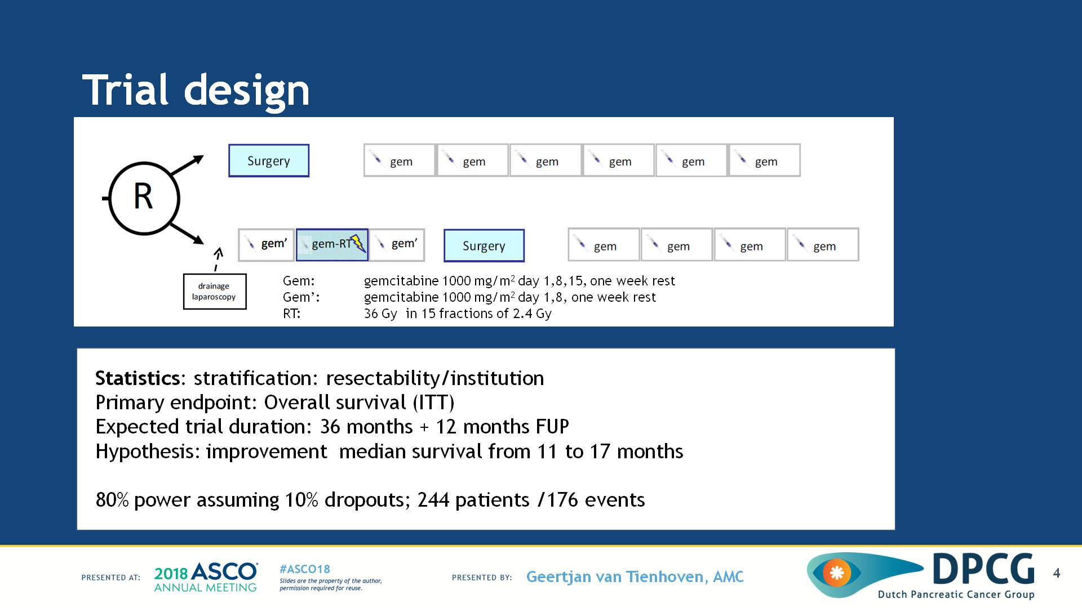
Trial design
NCT vs upfront surgery( PREOPANC)
Presented By Geertjan Van Tienhoven at 2018 ASCO Annual Meeting

Slide 26
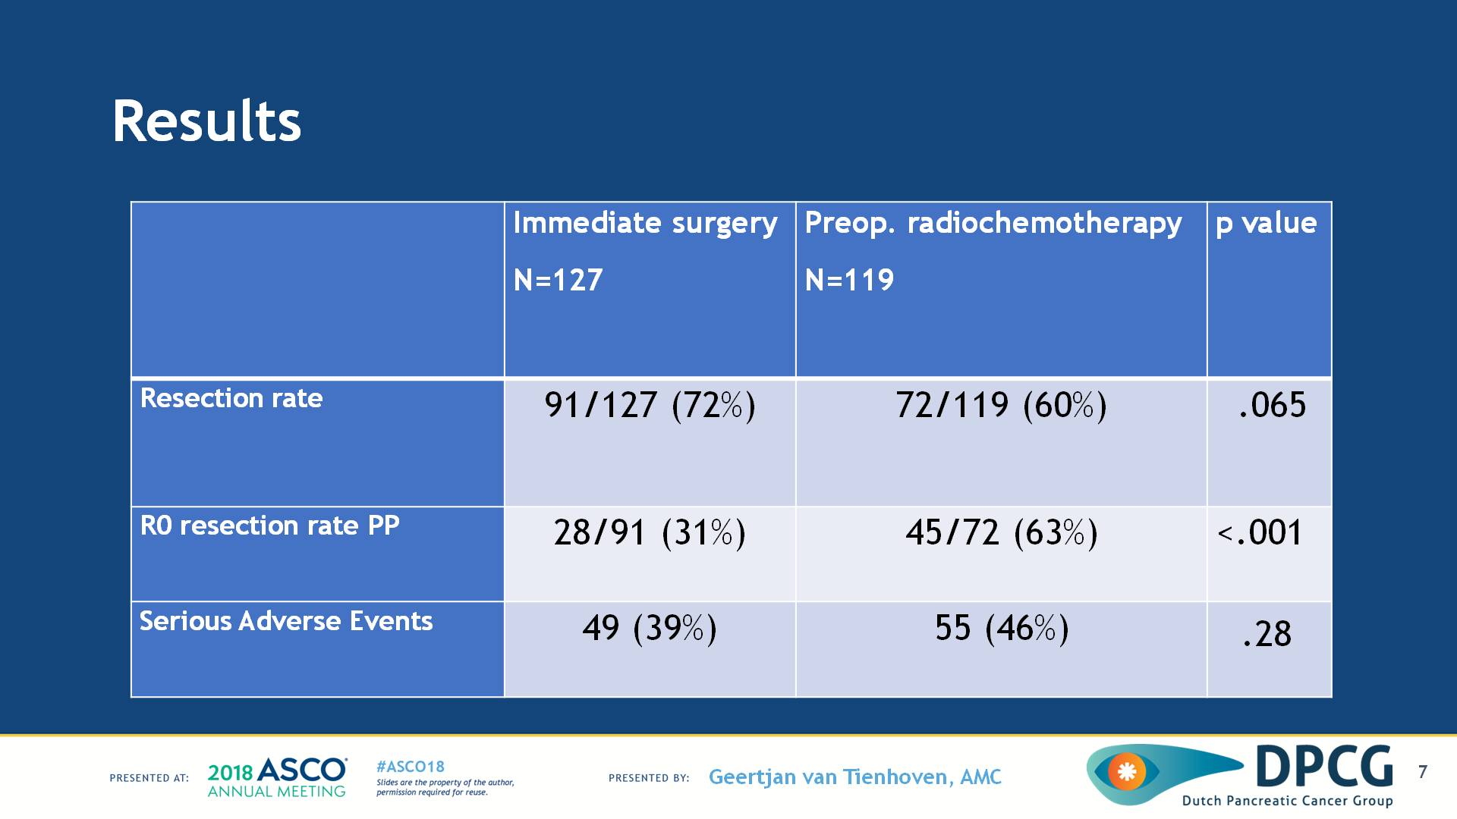
Results
NCT vs upfront surgery( PREOPANIC)
Presented By Geertjan Van Tienhoven at 2018 ASCO Annual Meeting

Slide 27
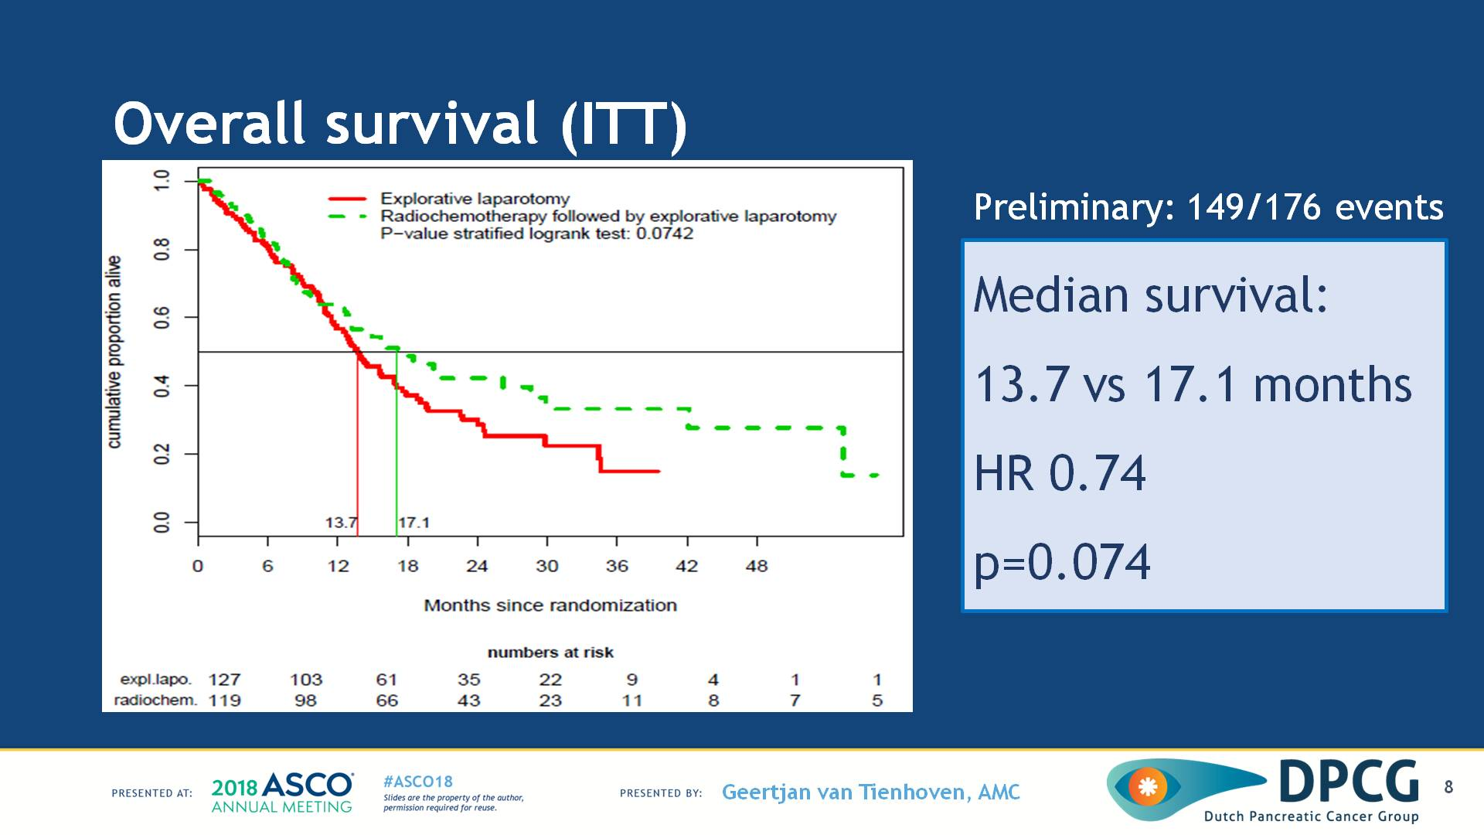
Overall survival (ITT)
NCT vs upfront surgery( PREOPANIC)
Presented By Geertjan Van Tienhoven at 2018 ASCO Annual Meeting

Slide 28
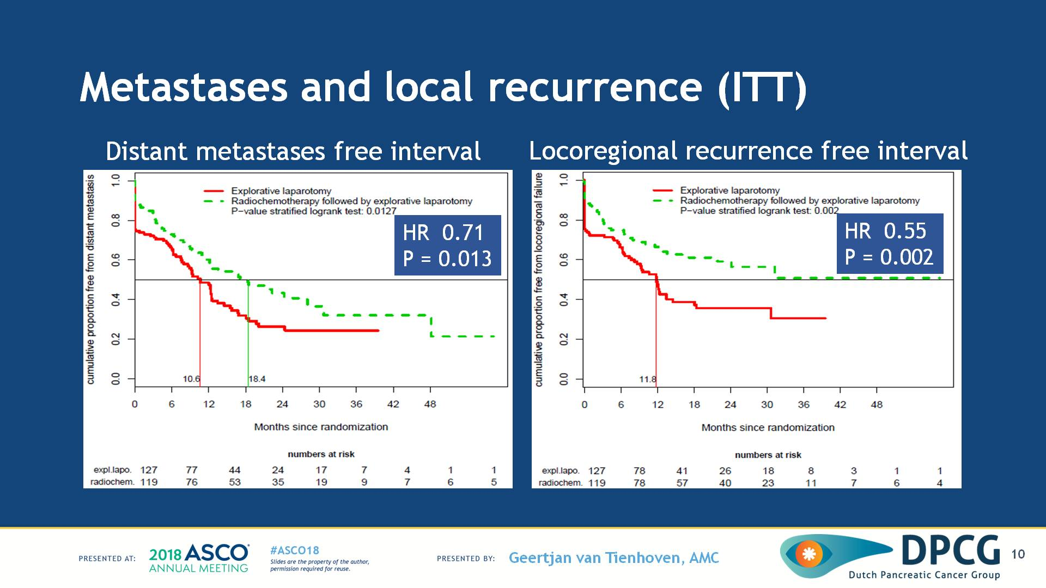
Metastases and local recurrence (ITT)
Presented By Geertjan Van Tienhoven at 2018 ASCO Annual Meeting

Slide 29
II. Neo vs adjuvant?
NEOADJUVANT
√

Slide 30
III. NCT-> how long +-NRT?

Slide 31

Extended chemo in panc ca. Rose et al ASO 2014
64 Borderline pts
6 months NCT (G/A)
31 (48%) resected
27 (87%) R0
3 (10%) PCR
75% of resected patients survived > 2 years

Slide 32

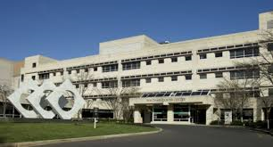
NCRT-Surgery interval
Chen et al ASO 2014
84 Borderline PDAC
Group C has only 10 patients , did not reach statistical significance for OS,
but significant pathologic response that was significant predictor of OS.

Slide 33
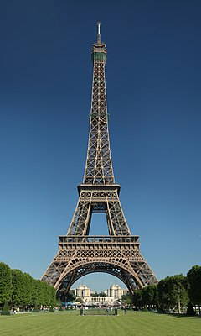

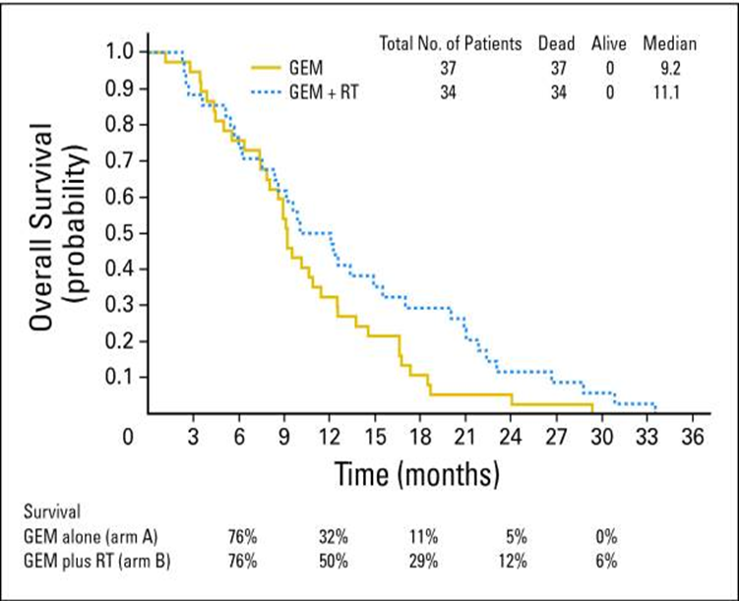
CRT vs. CT alone (5 RCTs ???)
Loehrer et al. JCO 2011
ECOG
74 patients
CRT improved OS with acceptable toxicity.
Chauffert et al. Ann Oncol 2008
2000–01 FFCD/SFRO
119 patients
CHRT was more toxic and less effective
OS

Slide 34
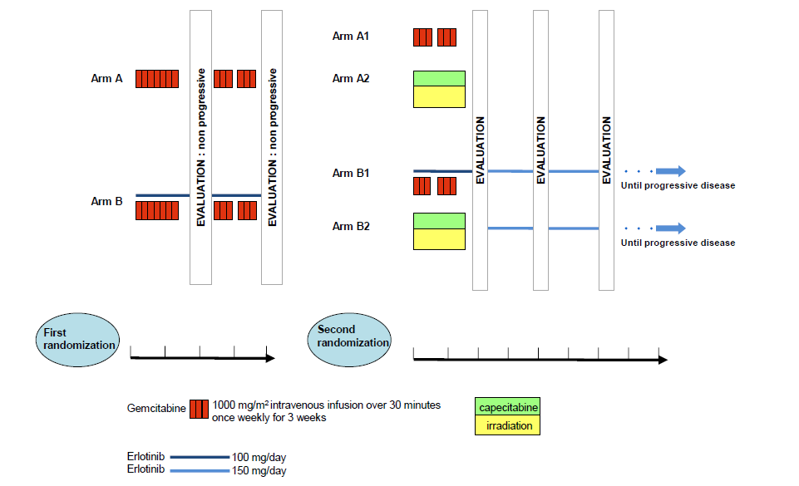


LAP07
Pascal Hammel et al. 2016 JAMA May 2016.
136 pts
223 pts
Gem
133 pts
133 pts
219 pts
Gem/Er
Old regimen->before the advent of FOLFIRINOX and Gem-abraxane.

Slide 35
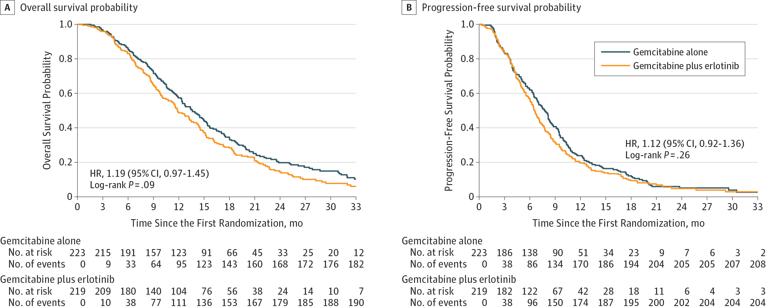
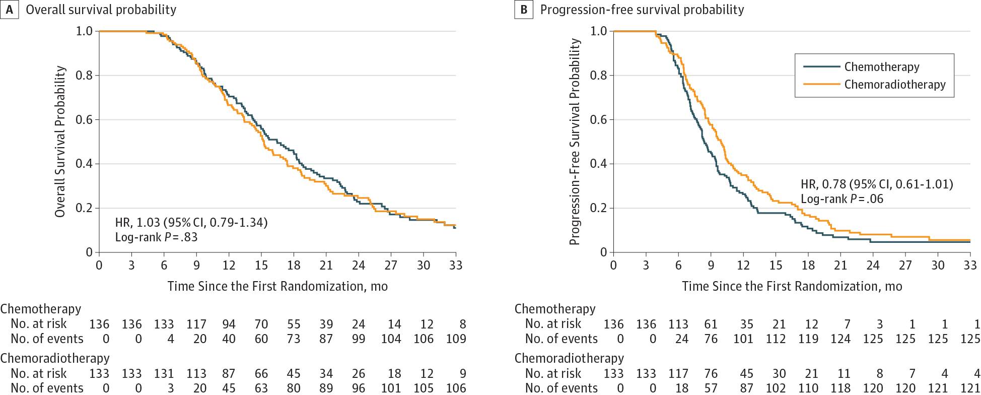
LAP07
Pascal Hammel et al. JAMA May 2016.

Slide 36
Surgery
LAP07
Pascal Hammel et al. JAMA May 2016.
Surgery
18 patients (4%)-> curative-intent resection.
12 after the completion of protocol.
8 pts (6%) CRT and 4pts (3%) after CT, p=0.25.
Median OS of these 18 patients was 30.9months.
LAP07
Pascal Hammel et al. JAMA May 2016.

Slide 37
LAP07
Pascal Hammel et al. JAMA May 2016.
Among, 269 patients who underwent the second randomization
progression was less frequent in CRT group (35 [32%]) than in CT group (58[46%]),
Metastatsis was more in CRT group (67 [60%]) than in CT group (55 [44%]; P = .04).

Slide 38
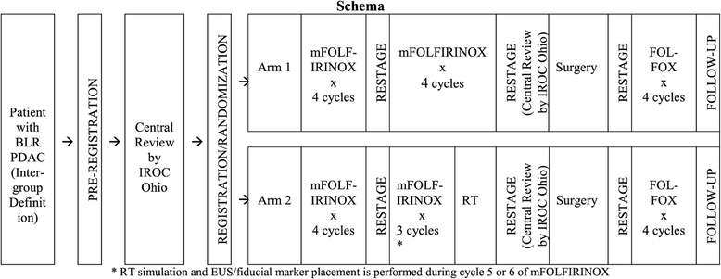
(ALLIANCE) trial A021501 extended NCRT vs NCT
mFOLFIRINOX vs mFOLFIRINOX+SBRT
Phase II
Suspended for interim analysis

Slide 39

III. NCT-> how long +-NRT?
Promising results with extended chemotherapy
NRT ???

Slide 40
Metrics of tumor response
Metrics of tumor response
Gemcitabine response: Human Equilibrative Nucleoside Transporter 1 (hENT 1) ??????
(conflicting and no commercial antibody avail)
Circulating tumor cells (LAP07). Ann Oncol Aug 2013
Micro-RNAs Pancreas July 2012
cfDNA (liquid Bx) JCO Feb 2014

Slide 41
Metrics of tumor response
Metrics of tumor response
Gemcitabine response: Human Equilibrative Nucleoside Transporter 1 (hENT 1) ??????
(conflicting and no commercial antibody avail)
Circulating tumor cells (LAP07). Ann Oncol Aug 2013
Micro-RNAs Pancreas July 2012
cfDNA (liquid Bx) JCO Feb 2014
Experimental

Slide 42
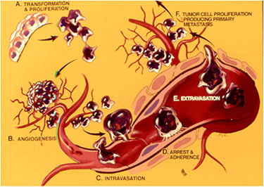
CTC
only 0.01% of CTCs have metastatic potential
Veridex Cell System-> only FDA approved
In met breast cancer: >5 CTC/7.5 ml->↓OS (p = 0.0006; Weissenstein et al , 2012)
Challenge in portal circulation (most of CTC entrapped by liver)
Various methodologies-> confuse researchers

Slide 43
Cont. Metrics of tumor response
Cont. Metrics of tumor response
CA 19-9
Imaging
Symptoms

Slide 44
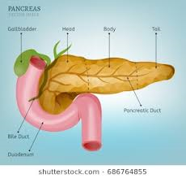
CA 19-9
CA 19-9
Sialyl Lewis antigen
Critical in WBC homing and metastasis
Discovered 1979 among CRC, later in PDAC
Secreted by normal biliary epithelium
~10% of the population->non secretor

Slide 45

CA 19-9
Boone et al ASO Dec 2014
78 patients
> 90% ↓ -> PCR was 29 %; p=0.001
< 90% ↓ -> PCR= 0%
> 50% ↓ -> ↑ OS (28 vs. 11 mon.; p < 0.0001)

Slide 46
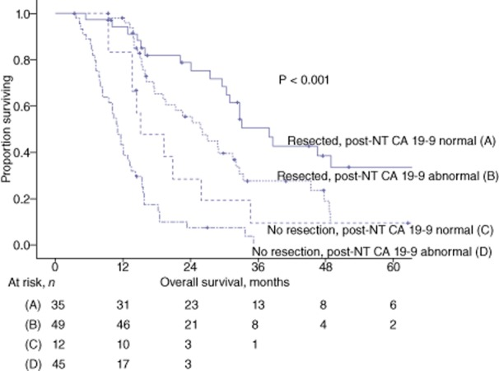

CA 19-9
Tzeng et al HPB May 2014
141 patients
The normalization of CA 19-9
Better OS
Resected
38 vs 26 months
P = 0.020
Non-resected
15 vs 11 months
P = 0.022

Slide 47


CA 19-9
Katz et al ASO July 2010
174 patients
68% completed NCRT->PD
PPV
93%
NPV
28%

Slide 48
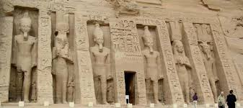
Imaging post-NCT

Slide 49


Katz et al. Cancer 2012
Response of BR PDAC to NCT is not reflected by radiographic indicators in 122 pts

Slide 50


Ferrone et al.Ann Surg 2015

Slide 51
Ferrone et al. Ann Surg 2015
54 year-old lady
56 year-old lady

Slide 52
Ferrone et al. Ann Surg 2015
54 year-old lady
pT3N0
56 year-old lady
pT0pN0
After neoadjuvant FOLFIRINOX imaging no longer predicts unresectability

Slide 53




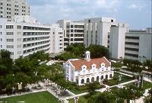
Pathological Complete Response to Neoadjuvant Chemotherapy in Pancreatic Cancer: Frequency, Predictors and Impact on Overall Survival
Basem Azab, MD; Caroline Ripat, MD; Igor Macedo, MD; Omar Picado, MD; Alan S Livingstone, MD; Dido Franceschi, MD; Nipun Merchant, MD; Danny Yakoub, MD PhD.

Slide 54
Reference | Institute/Country | Period | pCR
Snady et al (2000) | Mt Sinai NY (USA) | 1989-1997 | 3/20 (15%)
Turrini et al (2009) | Paoli-Calmettes (France) | 1996-2007 | 8/62 (13%)
Calvo et al (2004) | G Maranon (Spain) | 1998-2001 | 3/9 (33%)
White et al (2005) | Duke University (USA) | 1994-2005 | 4/54 (7%)
Lee et al (2016) | MD Anderson CC (USA) | 2008-2012 | 3/176 (2%)
Cloyd et al (2017) | MD Anderson CC (USA) | 1990-2015 | 23/583 (4%)
Chun et al (2011) | Fox Chase CC (USA) | 1987-2009 | 8/107 (7%)
He et al (2018) | John Hopkins (USA) | 2008-2016 | 19/186 (10%)
Pietrasz et al (2015) | Ageo-French cohort (France) | 2010-2013 | 12/80 (15%)
Hirata et al (2015) | Osaka medical center (Japan) | 2006-2011 | 6/157 (4%)
Lee et al (2015) | Yonsei University(South Korea) | 2000-2012 | 9/86 (10%)
Mellon et al (2017) | Mofitt CC (USA) | 2010-2015 | 6/81 (7%)
pCR varies widely between studies (2%-33%)

Slide 55
Background
 | PCR
Pancreas cancer | (2-15%)
Rectal cancer | (13-16%)
Esophagus cancer | (20-40%)

Slide 56
Methods
Methods
NCDB 2004-2014
Inclusion criteria
Exclusion criteria
AdenoCa
Neoadjuvant therapy
NCT-S >8 weeks
M1 disease
Missing pTN staging data

Slide 57
Methods
Methods
2093 patients were included
pCR was defined as ypT0,ypN0
NCT-S interval = start time of NCT to surgery-> was divided:
  Categorically into week quintiles (8-11, 12-14, 15-19, 20-29, >29)
  Per week basis as a continuous variable
Primary outcome: Rate of pCR
Secondary outcomes: OS

Slide 58
Results - Baseline characteristics
Baseline characteristics | pCR | Non-pCR | P Value
 | N=44 | N=2049
Demographic characteristics
Age (years, mean & sd) | 60±9.8 | 63±10.04 | 0.8
Gender (Males) | 20(46%) | 1040(51%) | 0.5
Race (White, %) | 41(93%) | 1788(87%) | 0.5
Facility type (community vs academic) | 6/44(14%) | 643/2044(32%) | 0.012
Cancer characteristics (N, %)
Tumor grade (Low) | 3/7(30%) | 171/1305(12%) | 0.07
TNM stage | 43 | 1819
cT stage |  |  | 0.3
cT1 | 2(5%) | 121(7%)
cT2 | 6(14%) | 438(24%)
cT3 | 28(65%) | 913(50%)
cT4 | 7(16%) | 347(19%)
cN0 stage | 31/42(74%) | 1209/1766(69%) | 0.5
Patients with pCR had higher chance to be treated at academic centers

Slide 59
Results - Baseline characteristics according to pCR status
Baseline characteristics | pCR | Non-pCR | P Value
 | N=44 | N=2049
Treatment characteristics
Neoadjuvant radiotherapy (NRT) | 37/44(84%) | 1438/2042(70%) | 0.049
Chemotherapy to surgery (weeks) | 23±13.1 | 17±8.1 | 0.001
Chemotherapy to surgery quintiles |  |  | 0.001
First quintile (8-11 week) | 5/44(11%) | 505/2049(25%)
Second quintile (12-14 week) | 9/44(21%) | 542/2049(27%)
Third quintile (15-19 week) | 8/44(18%) | 454/2049(22%)
Fourth quintile (20-29 week) | 12/44(27%) | 391/2049(19%)
Fifth quintile (>29 week) | 10/44(23%) | 157/2049(8%)
Patients with pCR had a higher rate of NRT and longer NCT-S interval

Slide 60
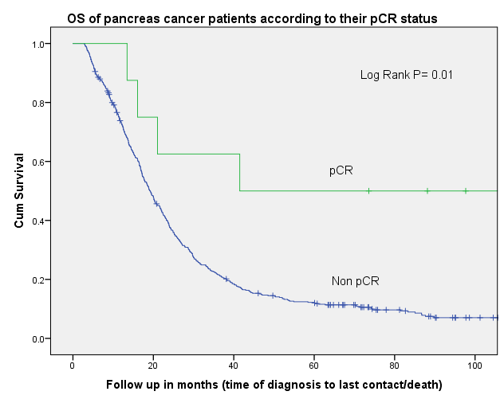
Results: OS according to pCR status
8 patients
 | Median OS
pCR | 59 months
Non-pCR | 19 months
516 patients

Slide 61
Logistic regression models of pCR predictors
 | Univariate analysis |  |  | Multivariate analysis
 | OR(95%CI) | P value |  | OR(95%CI) | P value
Age(per year) | 0.98(0.95-1.00) | 0.08 |  | 0.97(0.94-0.99) | 0.04
Sex(male) | 1.2(0.68-2.25) | 0.48 |  | 1.3(0.68-2.44) | 0.44
Race(White) | 2.3((0.56-9.69) | 0.25 |  | 5.8(0.78-43.14) | 0.08
Facility type (community vs academic) | 0.34(0.15-0.82) | 0.02 |  | 0.44(0.18-1.06) | 0.07
TNM stage(Ref: stage 1)
Stage 2 | 1.50(0.65-3.51) | 0.34 |  | 1.12(0.47-2.65) | 0.80
Stage 3 | 1.40(0.50-3.91) | 0.52 |  | 0.78(0.27-2.25) | 0.64
Neoadjuvant radiotherapy | 2.22(0.98-5.01) | 0.05 |  | 3.7(1.30-10.63) | 0.01
Neoadjuvant radiation dose(per cG) | 1.00(1.00-1.00) | 0.8
Neoadjuvant chemotherapy to surgery interval (Ref: 1st quintile 8-12 week)
5th quintile(>29 week) | 6.43(2.17-19.1) | 0.001 |  | 6.79(2.00-23.00) | 0.002
4th quintile(20-29 week) | 3.10(1.08-8.87) | 0.04 |  | 3.33(1.04-10.66) | 0.04
3rd quintile (15-19 week) | 1.78(0.58-5.48) | 0.32 |  | 1.78(0.51-6.19) | 0.36
2nd quintile (12-14 week) | 1.68(0.56-5.04) | 0.36 |  | 1.79(0.54-5.90) | 0.34
NCT-S interval (per week increase)* | 1.06(1.03-1.08) | 0.001 |  | 1.07(1.04-1.10) | 0.001

Slide 62
Results: pCR according to NCT-S interval
pCR rate was rising with longer NCT-S interval

Slide 63
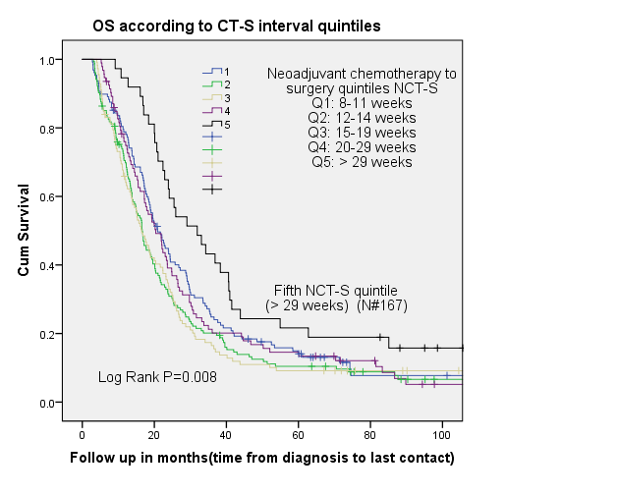
Results: OS per to NCT-S interval
 | Median OS
NCT-S Q1 | 21 months
NCT-S Q2 | 17 months
NCT-S Q3 | 16 months
NCT-S Q4 | 20 months
NCT-S Q5 | 32 months

Slide 64
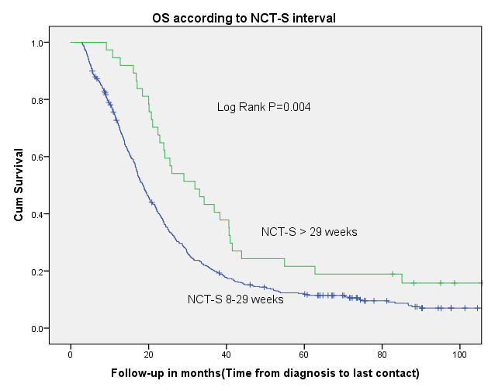
Results: OS per NCT-S interval
 | Median OS
NCT-S > 29 weeks | 32 months
NCT-S =<29 weeks | 18 months

Slide 65
Cox regression OS analysis
 | Univariate analysis |  |  | Multivariate analysis
 | HR(95%CI) | P value |  | HR(95%CI) | P value
Age(per year) | 1.02(1.01-1.03) | 0.001 |  | 1.03(1.01-1.04) | 0.001
Sex(male) | 1.01(0.84-1.21) | 0.9 |  | 0.78((0.62-0.99) | 0.04
Race(White) | 0.98(0.71-1.35) | 0.9 |  | 0.90(0.59-1.38) | 0.63
Facility type(community vs academic) | 1.14(0.95-1.40) | 0.2 |  | 1.31(1.02-1.68) | 0.03
TNM stage(Ref: stage 1)
Stage 2 | 0.85(0.64-1.14) | 0.3 |  | 0.78(0.58-1.05) | 0.1
Stage 3 | 1.11(0.81-1.53) | 0.5 |  | 1.19((0.85-1.65) | 0.3
Radiotherapy | 0.92(0.71-1.18) | 0.5 |  | 1.14(0.79-1.64) | 0.50
NCT-S interval (per week increase) | 0.99(0.98-0.99) | 0.02 |  | 0.98(0.97-0.99) | 0.04
Pathological complete response | 0.30(0.11-0.80) | 0.02 |  | 0.18(0.04-0.73) | 0.02
In MV analysis, both NCT-S interval and pCR were predictors of OS, while radiotherapy was not

Slide 66
Conclusions
Prolonged NCT-S interval:
  (> 20 wks) is associated with higher rate of pCR
  (> 29wks) is associated with improved OS
NRT was associated with higher rate of pCR, but it did not predict improved OS

Slide 67
Take home messages
FOLFIRINOX/Gem+Abraxane
Neoadjuvant better than upfront surgery
PCR is a reliable surrogate marker
CT/MRI in neoadjuvant setting(not reliable to judge resectability)
CA 19-9 normalization and drop >50%
NRT -> increase PCR (Need large number and long period to see impact on OS)
Waiting final results of PREOPANC

Slide 68




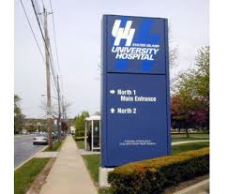



Thank you

